Slide 1

Optimizing Data Management: Building an Enterprise Data Warehouse for AgReliant Genetics

Slide 2


Problem Statement
Challenge:
Proposed Solution:
AgReliant Genetics relies on a data lake environment for storing data. Decision-making depends on raw, untransformed data, leading to:
Duplicated efforts
Inconsistent reporting
Lack of trust in data
Build an enterprise data warehouse using Snowflake to standardize data and improve reporting by building a standardized transformation and reporting layer and establish data governance and standards.

Slide 3




Project Plan with Refined Scope
Data Understanding
Identify what data AgReliant Genetics collects and stores.
Determine how different teams access and use this data for decision-making.
Understand current reporting mechanisms and data dependencies.
Project Plan
Aggregate Multi Year Schema
01
Develop approaches to simplify multi-year analytics
using datatables.xlsx.
Snapshot
Schemas | 18
Unique tables | 64
BSTI Schema
Tables | 19
Total Rows | 3.3 M
Largest Table (Product Pricing) | 1.5 M
02
Data Modeling
Work with the new multi year schema and build a framework for data modeling
03
Data Governance
Establish Data Governance principles

Slide 4


Snowflake Features
Scalability
Immutable Micro Partitions
Security Governance
Snowflake's architecture allows independent scaling of compute and storage resources for efficiency.
Data is stored in immutable micro partitions to enhance performance and security.
Robust security features include encryption, authentication, and comprehensive governance tools.

Slide 5
Proposed Solution
1) Simplifying Multi-year Analytics
2) Data Modeling using Kimball Modeling
3) Data Governance

Slide 6


Simplifying Multi-year Analytics
1. Aggregating Multi year schema
Aggregate Multi year schemas into one single schema
BSTI_2022
BSTI_2023
BSTI_2024
2. Adding Year field
Add Year Column dynamically
Dynamically adding year field to each schema for identification purposes
BSTI_Agg
3. Partitioning
Snowflake has inbuilt powerful partitioning mechanism called micro partitioning which makes sure there's no performance degradation in large tables

Slide 7
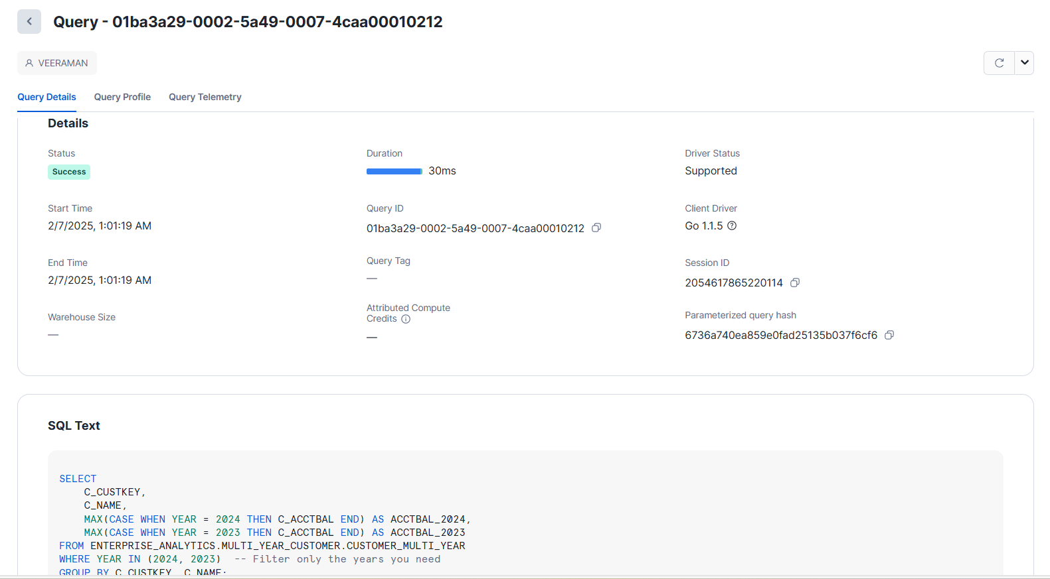
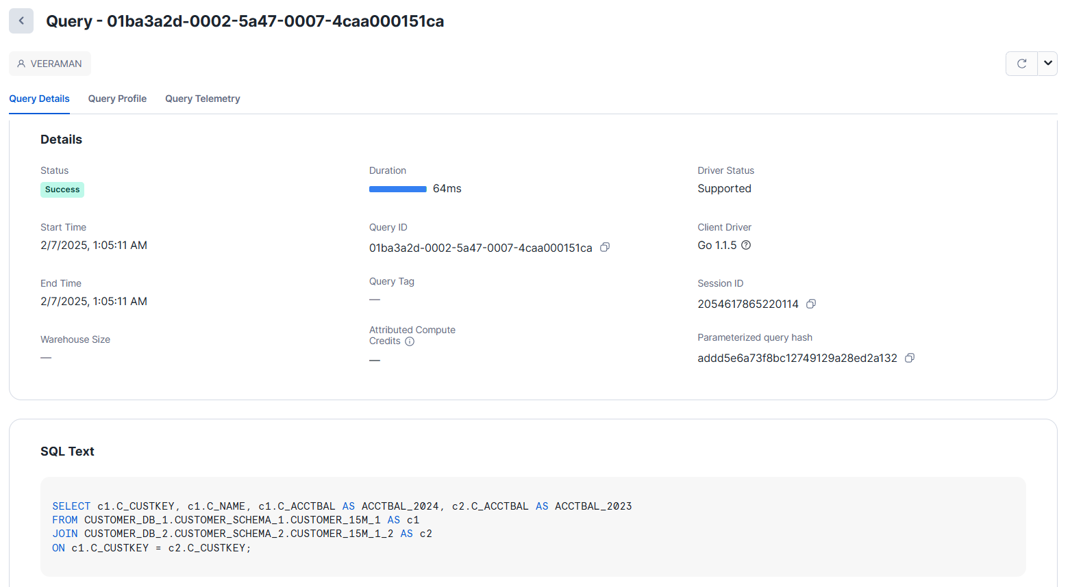
POC using snowflake free tier account
Query Time in Aggregating Master Table
Query Time in Joining Tables
Query Times Decreased by more than 50%

Slide 8
1) Simplifying multi-year analytics
2) Data Modeling using Kimbell Modeling
3) Data Governance

Slide 9
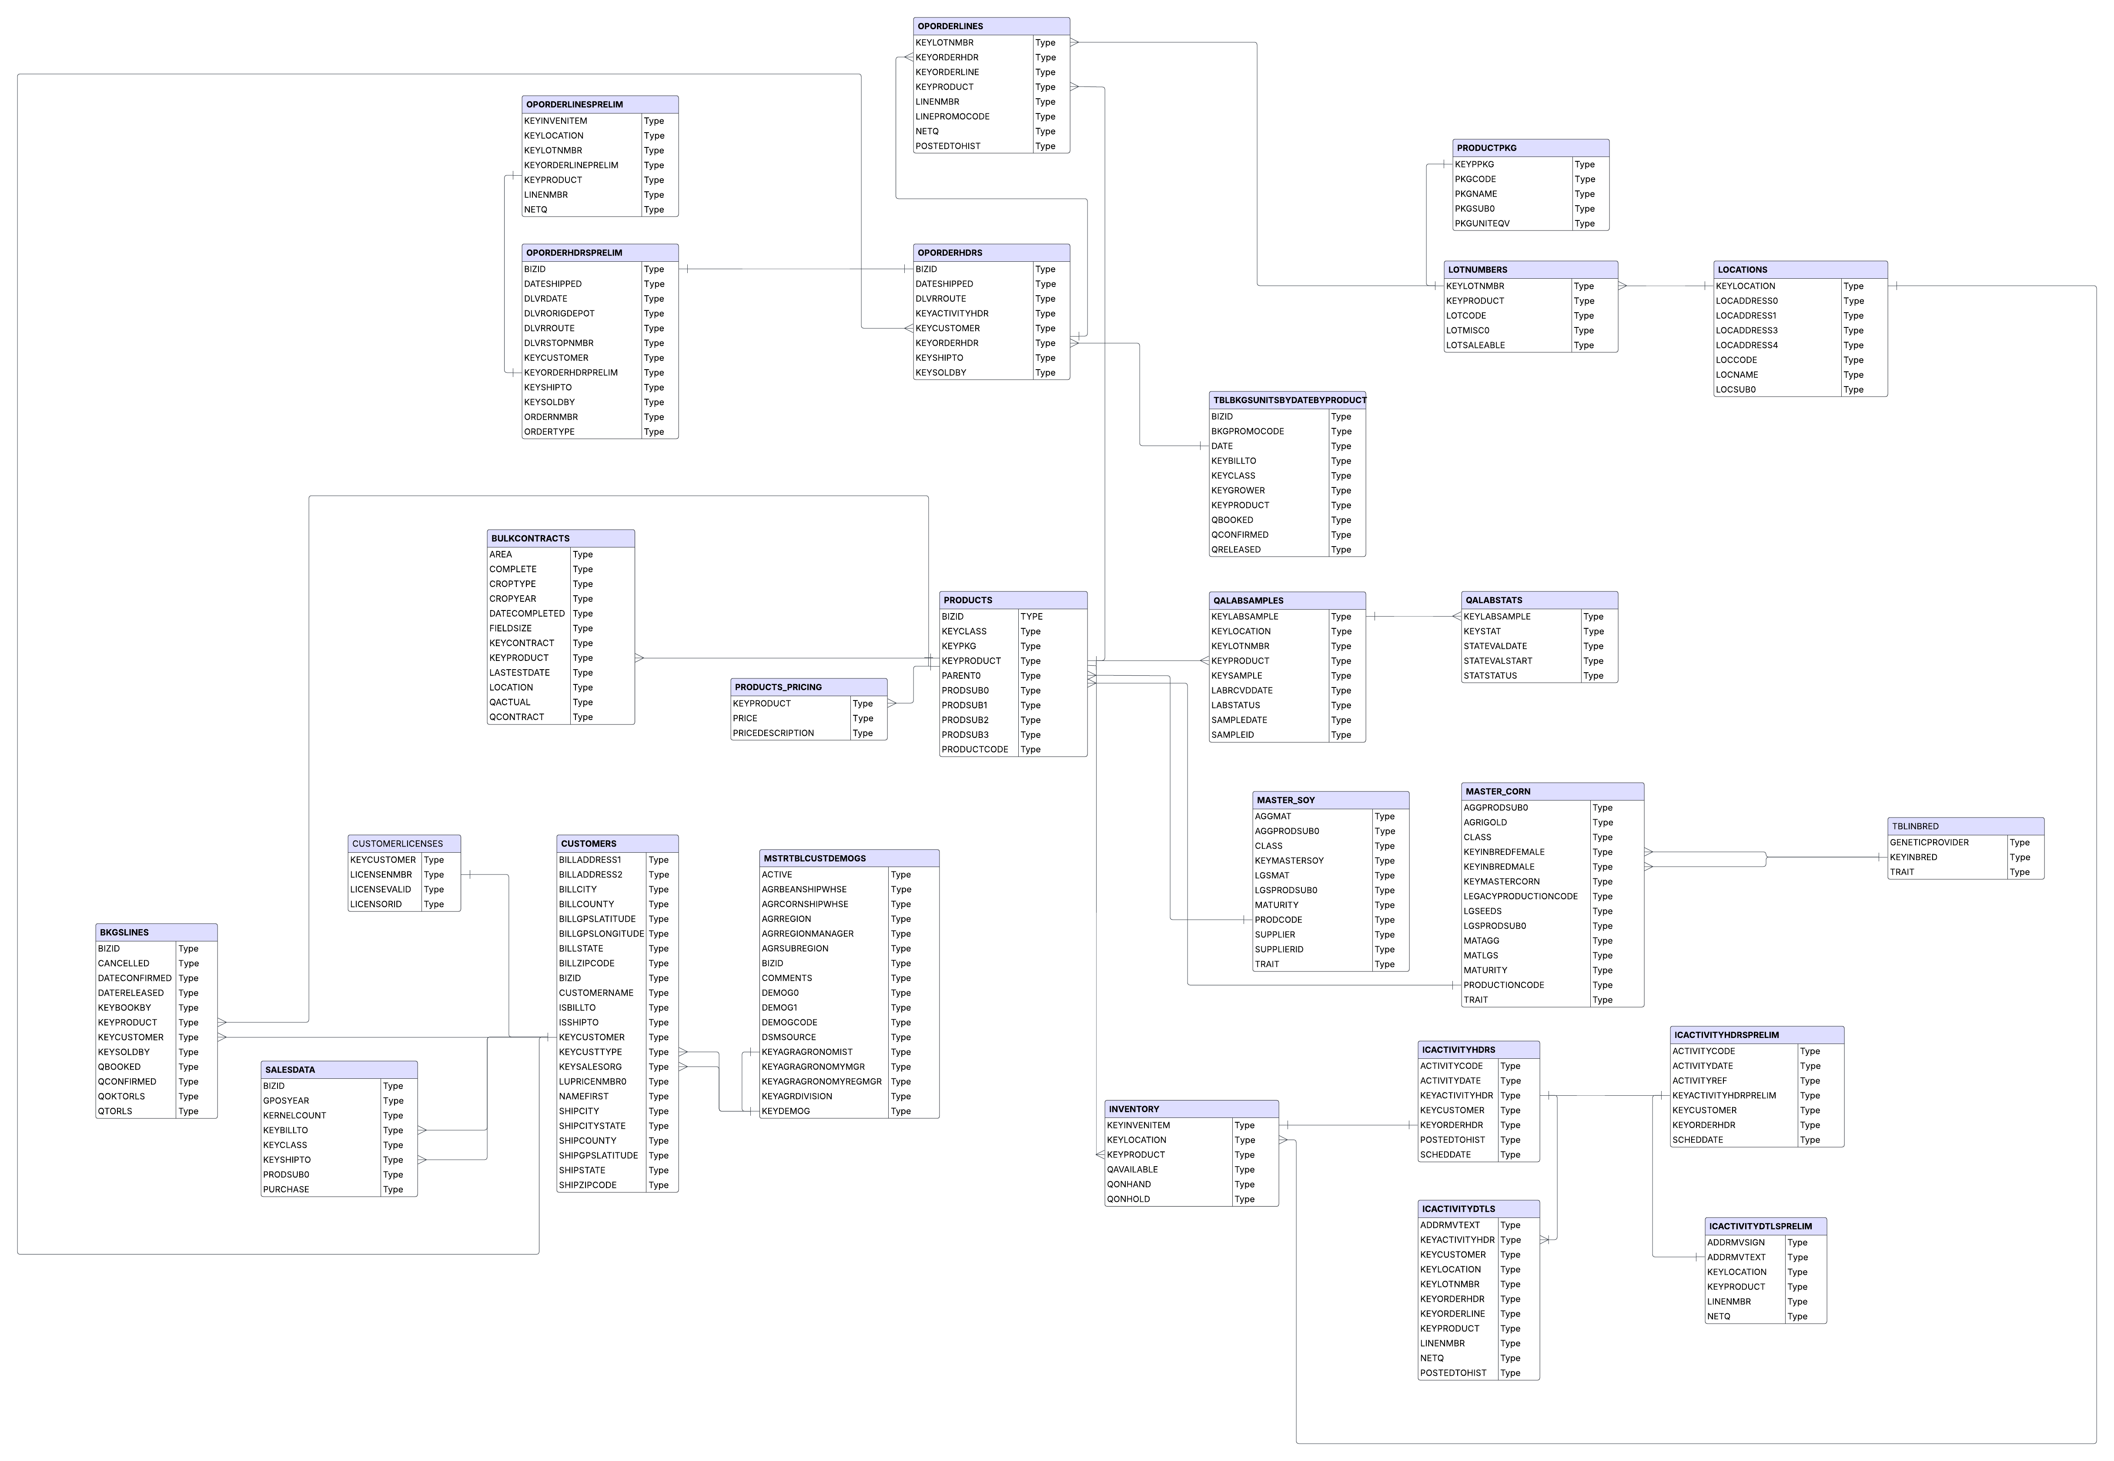
Current Structure

Slide 10




Data Modeling using Kimball Modeling
Sources
Staging (data lake)
Star Schema
Analytics (Marts)

Slide 11

Data Modeling using Kimball Modeling
01
Understand Business processes
02
Identify and Create Fact Tables
Identify and understand business processes
Low Granularity
Map the current Entity Relationship Diagram
Contains a primary key and the foreign keys of dimension tables
Understand dependencies and users
Has only numerical columns
03
Create Dimension Tables
04
Create Data Marts
Attributes and Descriptions
Join Facts and Dimensions to create custom views
Adds Context to the Fact
Can be slowly changing
Periodically updated through ETL process
Aids in data consistency across the organization

Slide 12
Create Fact Table
Transactions Table
ID | Order ID | Product ID | Date | Quantity | Unit Price | Customer Name
12345 | 234 | 34 | 12/3/25 | 5 | 20 | Text
Dim_Customer
Dim_Product
Fact_Transactions
Fact_Transactions Table
ID | Order ID | Product ID | Customer ID | Location ID | Quantity | Price Per unit | Total
12345 | 234 | 34 | 4 | 3 | 5 | 20 | 100
Dim_Location
Dim_Order

Slide 13

Create Dimension Table
Product Table
Product ID | Product Desc | Product Price | Product spec
12345 | Text | 10 | Text
Product
packaging
Packaging Table
ID | Product ID | Packaging EQV | Pkg Desc
12345 | 12345 | 0.5 | Text
Dim_Customer
Dim_Product
Fact_Transactions
Dimension_Product Table
Product ID | Product Desc | Product Price | Product spec | Packaging EQV
12345 | Text | 10 | Text | 0.5
Dim_Location
Dim_Order

Slide 14
Create Data Marts
Fact_Transactions Table
ID | Order ID | Product ID | Customer ID | Location ID | Quantity | Price Per unit | Total
12345 | 234 | 34 | 4 | 3 | 5 | 20 | 100
Dim_Product
Dimension_Product Table
Dim_Customer
Product ID | Product Desc | Product Price | Product spec | Packaging EQV
2345 | Text | 10 | Text | 0.5
Fact_Transactions
Mart_Revenue by Product
Product ID | Product Desc | Revenue
34 | Text | 100
Dim_Location
Dim_Order

Slide 15
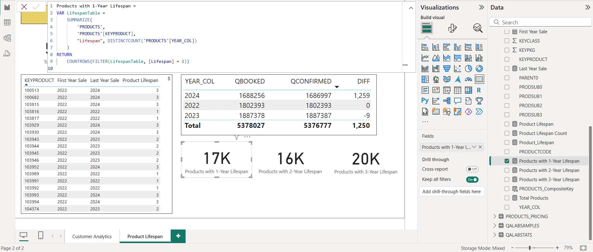
Before Data Modeling

Slide 16
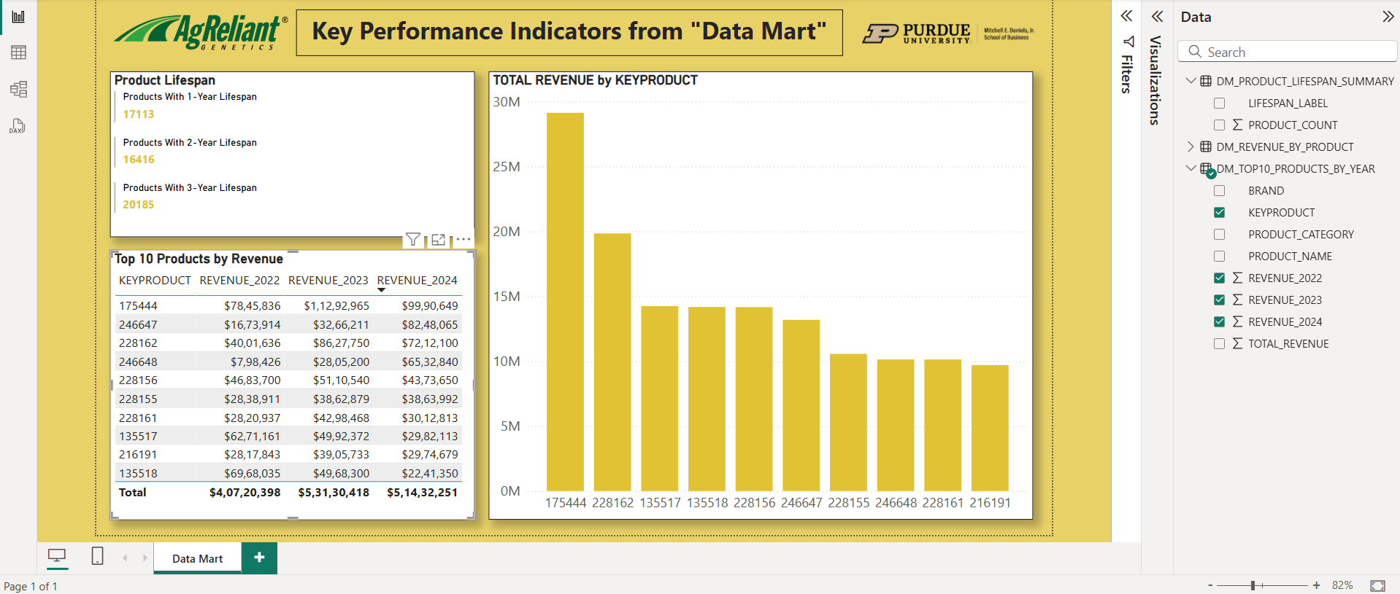
After Data Modeling

Slide 17
1) Simplifying multi-year analytics
2) Data Modeling using Kimball Modeling
3) Data Governance

Slide 18
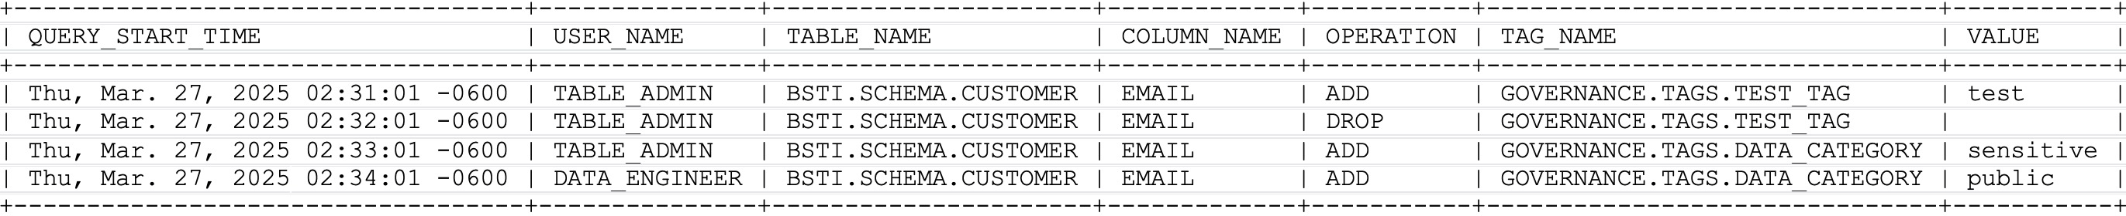
Data Governance Policies
Privacy and Security
Object Access Monitoring: There should be an access control mechanism in place that:
Logs who accessed which objects (database/table/view), when, and how.
Provides visibility into queries run, tables accessed, and role-based permissions.
Solution → Access History to track and audit data access for security & compliance.
Figure: Access History in Action

Slide 19
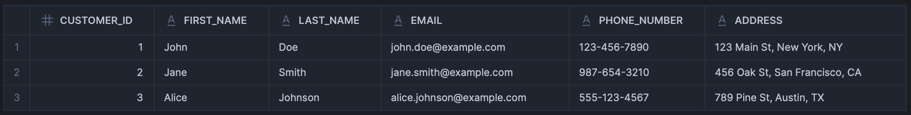
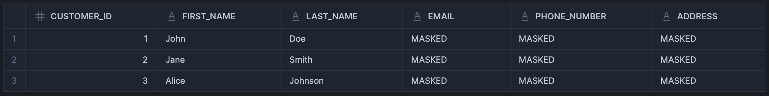
Data Governance Policies
Privacy and Security
Protection of Sensitive Data: Should be masked dynamically based on user roles to prevent unauthorized access.
PII Data, Proprietary Data and Bookings Data should have limited access to maintain confidentiality.
Solution → Tag-Based Masking allows applying masking policies dynamically to all tagged columns.
Figure: Data Before Masking
Figure: Data After Masking

Slide 20
Data Governance Policies
Usability and Integrity
We identified challenges that could hinder effective data usage and result in data inconsistencies:
Schema inconsistencies in BSTI tables: New columns were added each year, causing difficulties in merging multi-year data. Future schema changes should be carefully evaluated and governed.
Inconsistent field naming conventions: Similar fields were labeled differently across tables (e.g., prod_code vs. prd_cd), leading to confusion and extra effort during data integration.
Lack of data dictionary: The absence of a data dictionary made it difficult to understand field definitions. Establishing and maintaining it is crucial for ensuring data transparency and onboarding efficiency.

Slide 21
Data Governance Policies
Usability and Integrity
To address these issues and improve consistency, we recommend the following:
Establish a Data Standardization Document:
Defines consistent naming conventions, data formats, and schema design across all systems
Outlines rules for handling nulls, units of measurement, and datatype consistency
Prevents ad hoc schema changes by enforcing version control and review processes
Develop and Maintain a Data Dictionary:
Serves as a centralized repository for all data fields, including definitions and data types
Documents allowed values, field-level business rules, and table relationships
Enhances data transparency, onboarding efficiency, and communication between teams

Slide 22


Final Takeaways and Strategic Recommendations
Unified Historical Data Layer
Dimensional Modeling Framework
01
Ready for adding future years by plugging into the same merge logic
02
Use this framework (with existing ERDs) to restructure current schema and align the entire analytics pipeline.
BI-Ready Data Marts with Locked-in KPIs
Data Governance & Masking for PII Protection
03
04
Business users can pull metrics directly from data marts without reinventing business logic
Extend tag-based governance across more domains (Sales, HR, Customer Feedback, etc.)

Slide 23
References
Kimball Group. (n.d.). Dimensional Modeling Techniques. Retrieved from https://www.kimballgroup.com/data-warehouse-business-intelligence-resources/kimball-techniques/dimensional-modeling-techniques
McKinsey & Company. (2023). Unlocking data-driven growth in enterprises. Retrieved from https://www.mckinsey.com/business-functions/mckinsey-digital/our-insights/unlocking-data-driven-growth-in-enterprises
Sawant, N., & Shah, H. (2013). Big data application architecture Q&A: A problem-solution approach. Apress.
Malinowski, E., & Zimányi, E. (2008). A conceptual model for temporal data warehouses and its transformation to the ER and the object-relational models. Data & Knowledge Engineering, 64(1), 101–123.
Kulkarni, R., & Munjala, S. (2023). Data quality management in Snowflake cloud platform. Journal of Data Engineering, 35(4), 215–230.
Zainol, A., & Hassan, N. (2017). Data warehouse schema for monitoring key performance indicators (KPIs) for university teaching and learning using goal-oriented approach. Journal of Information and Communication Technology, 16(2), 45–62.
Chen, J., & Wang, R. (2022). Integrating unstructured data into data warehouses using NLP techniques. Journal of Data Science and Analytics, 29(3), 123–138.
Katasani, D. P. (2025). Implementing robust data governance frameworks in the Snowflake platform. International Journal of Scientific Research in Computer Science, Engineering and Information Technology, 11(1), 274–281. https://doi.org/10.32628/CSEIT25111226

Slide 24
Appendix

Slide 25
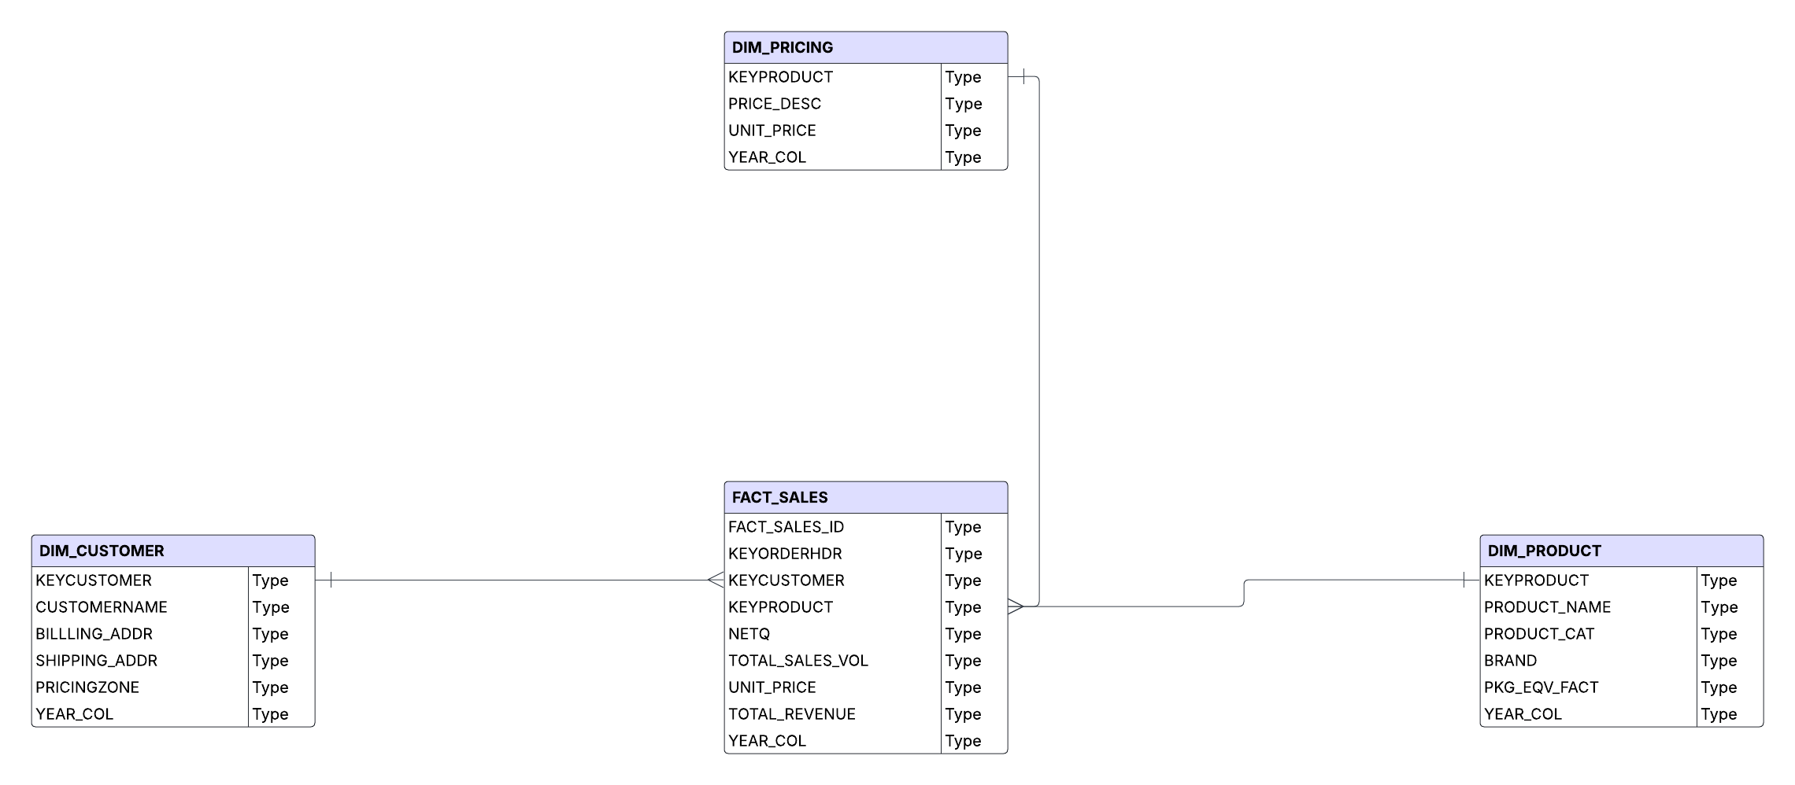
After Data Modeling

Slide 26
Agreliant revenue reporting before and after Kimball Modeling
Calculate Sales Volume using CTE
Identify Customer zones using CTE
Pull data from already created Data mart for revenue by product
Product pricing info using CTE
Before
After
Match Sales with prices using CTE
Final Revenue Output
Group Revenue by product

Slide 27
Thank You

